Slide 1
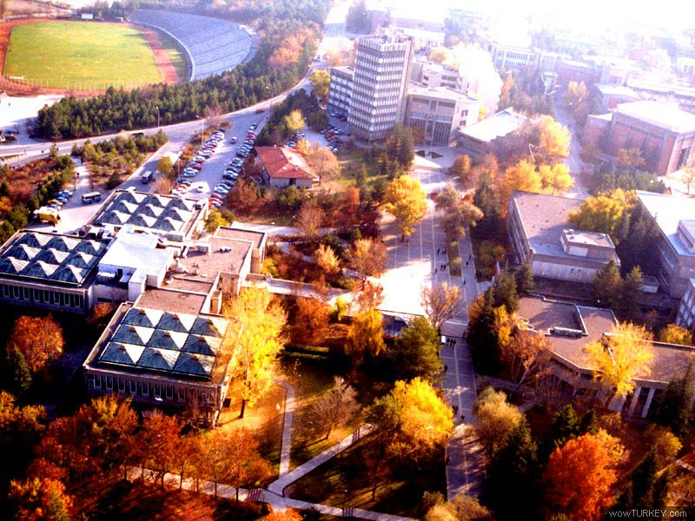
METUGEM '07
Middle East Technical University

Slide 2
HOW ?
Somebody (an undergrad) learned about synthetic biology
and asked himself…
Why nobody else around me know about it?
They found out iGEM’06
and told others…
and asked themselves…
Why aren’t we there?
and they set up a team…
METUGEM ‘07
Notes:
Here is the story: An undergraduate first learned about synthetic biology and thought that it is really interesting, and she/he was surprised to see that nobody else around him know about it. So he/she told others about it. They found out about iGEM’06 and they asked themselves “why aren’t we participating?” And they decided to make up a team; METUGEM. Here we are! We were really excited to be a part of iGEM, but…

Slide 3
Not everything went as planned..!
But then…
First time on our own…
We were inexperienced!
Information…
Money…
Timing…
Nobody else around us knew about SB;
Our schedule was not aligning with that of iGEM;
The bureaucracy was taking so long;
Educating ourselves
Convincing others
Summer practice requirement
Money coming late
Lab stuff not in stocks
Notes:
Then not everything went good. Because this was the first time we were doing a project with all its organizational and financial aspects, we suffered a lot from being inexperienced. There were three main issues that caused problems. First was lack of information. There were no ongoing synthetic biology projects in Turkey and nobody around us knew as much as we did, so we were on our own and we had to educate ourselves. Also we had to convince everybody else that synthetic biology will be a very important area in the future, and somebody should start doing some research on it. Second issue was about the timing. The competition schedule was based on the summer, but as juniors then we were to be involved in research in different institutions as a summer practice as required by our undergraduate curriculum. Our schedule was not aligning with that of the competition. To catch up, we started as early as February, but then came the third problematic issue, money. Although we managed to find a good deal of money thanks to our supporters Synbiocomm, Tubitak and METU, we got the money as late as late September because of all the long and tiring bureaucracy. When we were finally rich, we sadly saw that none of the indispensible chemicals like enzymes, kits were found in the stocks in Turkey and the delivery was usually taking 1.5-2 months; so things were not good for us… Still…

Slide 4
Still…
We were determined!
We;
made presentations
talked to students and instructors
To draw attention to Synthetic Biology in Turkey
To pioneer the first undergraduate project in our department
To attend to the Jamboree
got ready for the iGEM’08; allocated lab space and bought materials
worked on 3 project ideas theoretically
and now we are here…
Notes:
We were determined to do as much as we can. We had three main aims. We wanted to draw attention to the developments in synthetic biology in Turkey, so we made presentations and talked to students and instructors, in fact whoever we can find. We wanted to pioneer the first undergraduate project in our department. Normally undergraduates are involved in research, but there hasn’t been a project that has been done entirely by undergraduates before. We wanted to make a start and we wish that METUGEM will be participating in iGEM regularly from now on. So although we couldn’t manage to do any real experiments this year; we have allocated lab space, bought materials, learnt necessary scientific procedures and the bureaucracy, hence we got ready for the next year. And finally we really wanted to attend to the Jamboree, because we thought this would be an invaluable experience and we would learn a lot; so we continued working on three project ideas at least theoretically and now here we are in the Jamboree and we are very happy.
My friend Koray will be talking about two of these ideas, which are Mexican Wave and Chase Simulator. Then, Milas and Elif will continue with the Metal Transporter. Thank you.

Slide 6
Mexican Wave

Slide 7
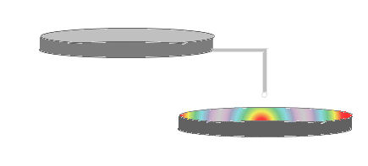
Aim
To create a mechanism that can signal an event in a funny manner

Slide 8
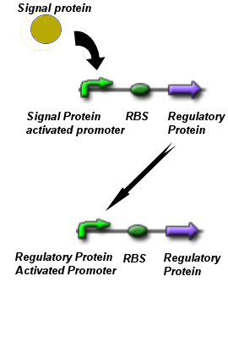
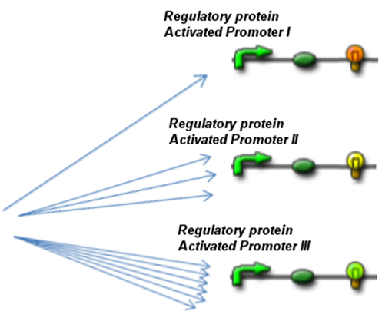
Signal protein that is result of an event

Slide 9
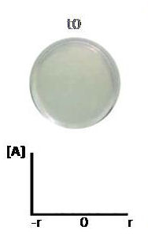
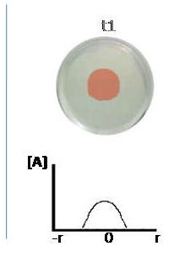
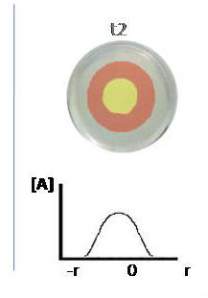
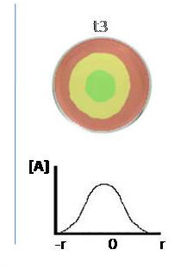
What do we expect to observe?

Slide 10
Chase Simulator

Slide 11
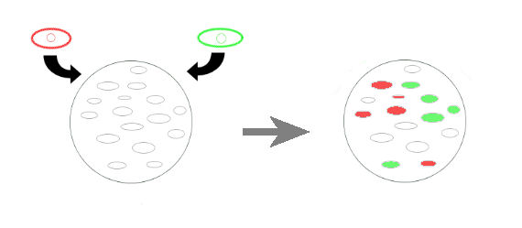
Aim
To create 2 kinds of invader cells that compete on lawn of neutral cells

Slide 12
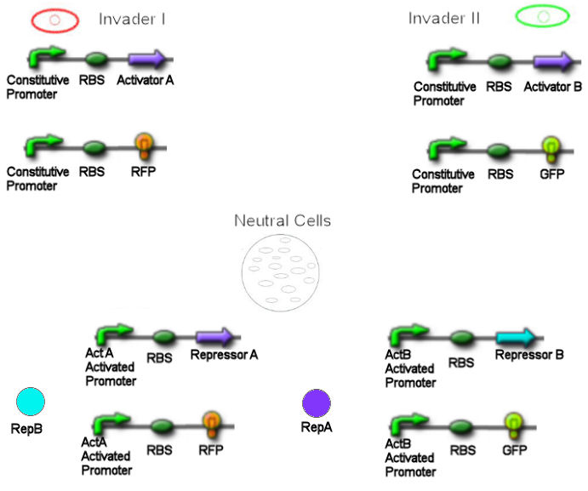
Mechanism

Slide 14
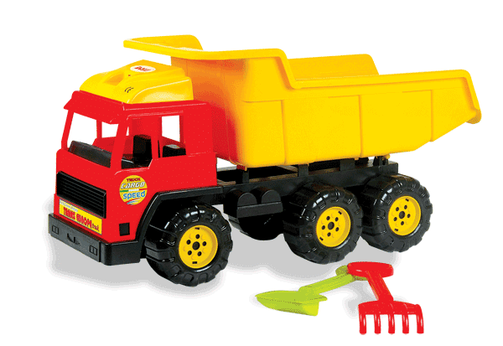
Metal Transporter

Slide 15
Metal-binding domains
eg. CVNGCVPSK
for Mercury
Cu, Cd, Ag, Hg, Sb, Tl,
Zn, Co, As, Cr, Mb, Mg,
Fe, K, Te...
F

Slide 16
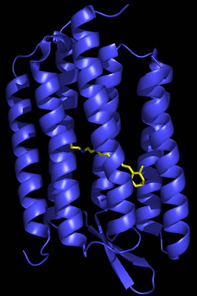
Bacteriorhodopsin
Transmembrane protein
Cis-trans isomerization
Proton pumping

Slide 17
Phototaxis

Slide 18
Fusion constructs for Phototaxis
Jung et al. (2001)‏

Slide 20
Stage 1

Slide 21
Stage 2: Metal Binding

Slide 22
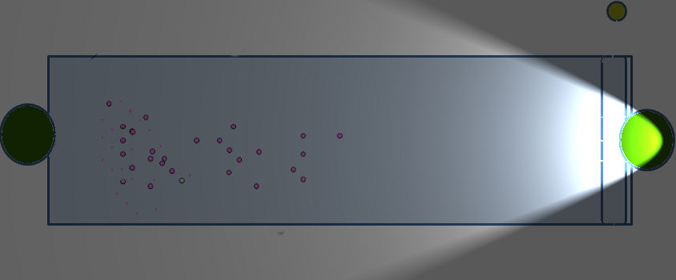
Stage 3: Moving towards light

Slide 23
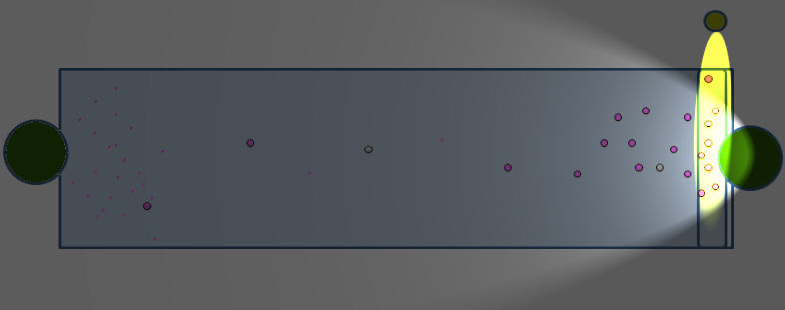
Stage 4. Reaching to destination

Slide 24
Stage 5: Releasing metal ions

Slide 25
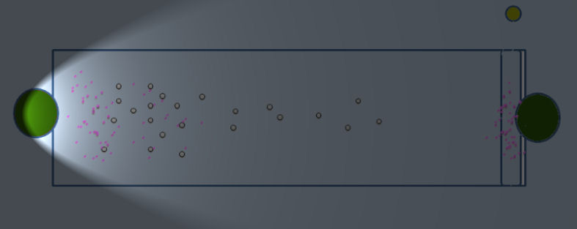
Stage 6: Returning…

Slide 27
References
In silico identiﬁcation of putative metal binding motifs, Richard Thilakaraj, Krishnan Raghunathan, Sharmila Anishetty and Gautam Pennathur, 2007 Bioinformatics, Vol. 23 no. 3, pages 267–271
An Archaeal Photosignal-Transducing Module Mediates Phototaxis in Escherichia coli, Kwang-Hwan Jung, Elena N. Spudich, Vishwa D. Trivedi, and John L. Spudich, 2001, Journal of Bacteriology,Vol 183 No:21, p. 6365–6371
Engineering the Escherichia coli outer membrane protein OmpC for metal bioadsorption, Norberto Cruz, Sylvie Le Borgne, Georgina Hern´andez-Ch´avez, Guillermo Gosset, Fernando Valle & Francisco Bolivar, 2000, Biotechnology Letters 22: 623–629
Molecular basis of transmembrane signalling by sensory rhodopsin II–transducer complex, Valentin I. Gordeliy, Jorg Labahn, Rouslan Moukhametzianov, Rouslan Efremov, Joachim Granzin, Ramona Schlesinger,Georg Buldt, Tudor Savopol, Axel J. Scheidig, Johann P. Klare & Martin Engelhard, 2002, Nature, Vol 419, 484-486
Genetic cloning and functional expression in Escherichia coli of an archaerhodopsin gene from Halorubrum xinjiangens, Jie Feng, Hong-Can Liu, Jin-Fang Chu, Pei-Jin Zhou, Ji-An Tang Æ Shuang-Jiang Liu, 2005, Extremophiles, 10: 29-33
http://www.cocuksepeti.com/images/7011-b.gif

Slide 28
What have we learnt?
Organizational manners:
starting a team,
funding,
preparing a whole money and time planning,
ordering lab equipments and materials,
Biobrick Strategy:
designing parts,
using the wiki and the registry
Protocols:
practicing synthetic biology

Slide 29
Special Thanks to:
SYNBIOCOMM and Sven PANKE
TÜBİTAK
METU
Gülay ÖZCENGİZ, Mahinur AKKAYA and Sertaç ÖNDE
Pamela SILVER from HMS

